Slide 1
8.2 Arrays
The use of arrays

Slide 2
What is an array?
RANDOM ACCESS MEMORY | ADDRESS | INSTRUCTION/DATA
 | 01
 | 02
 | 03
 | 04
 | 05
 | 06
 | 07
 | 08
 | 09
 | 10
 | 11
 | 12
An array can be thought of as a variable that can contain more than one data item – e.g., storing a list of names.

Slide 3
What is an array?
RANDOM ACCESS MEMORY | ADDRESS | INSTRUCTION/DATA
 | 01
 | 02
 | 03
 | 04
 | 05 | Boris
 | 06 | Marek
 | 07 | Jane
 | 08 | Ryan
 | 09
 | 10
 | 11
 | 12
An array can be thought of as a variable that can contain more than one data item – e.g., storing a list of names.
We can do that by allocating a contiguous part of memory for the purpose of storing that data.
Contiguous means all the data is stored together, one element after the other.
Note: Lists are different to arrays because lists are not contiguous.

Slide 4
What is an array?
RANDOM ACCESS MEMORY | ADDRESS | INSTRUCTION/DATA
 | 01
 | 02
 | 03
 | 04
 | 05 | Boris
 | 06 | Marek
 | 07 | Jane
 | 08 | Ryan
 | 09
 | 10
 | 11
 | 12
An array can be thought of as a variable that can contain more than one data item – e.g., storing a list of names.
We can do that by allocating a contiguous part of memory for the purpose of storing that data.
Contiguous means all the data is stored together, one element after the other.
Note: Lists are different to arrays because lists are not contiguous.
This program will know the position in memory where the array starts – in this case, address 05.
The program uses an index relative to this start point to allow us to easily access the array’s contents.
So, “Jane” is at index 2.
index
[0]
[1]
[2]
[3]

Slide 5
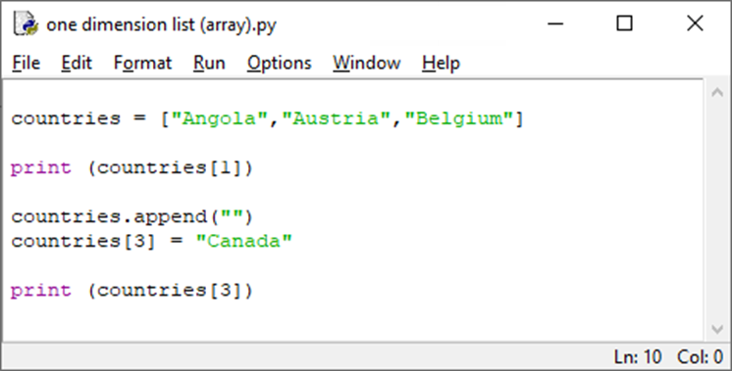
One-dimensional arrays (Python)
This line sets up a one-dimensional array of strings called “countries”.
It assigns the initial values of:
“Angola” at index 0
“Austria” at index 1
“Belgium” at index 2
Note how indexes start at 0 and not 1.
Python actually uses arrays but allows programmers to use them as lists. That’s why most people think Python only supports lists.
countries
Index | Contents
0 | Angola
1 | Austria
2 | Belgium

Slide 6
One-dimensional arrays (Python)
To output “Austria” from the array, we would need to use index 1, as index 1 represents the second item in the “countries” array.
countries
Index | Contents
0 | Angola
1 | Austria
2 | Belgium

Slide 7
One-dimensional arrays (Python)
Arrays are a static data structure – that means you can’t change the size of an array once you have set it up.
This is a good example of Python allowing an array to behave like a list. Although you can’t tell (because it is abstracted from you), Python is actually moving the entire data structure to a new part of the memory to ensure it is contiguous if it needs to be.
countries
Index | Contents
0 | Angola
1 | Austria
2 | Belgium
3

Slide 8
One-dimensional arrays (Python)
Arrays are a static data structure – that means you can’t change the size of an array once you have set it up.
This is a good example of Python allowing an array to behave like a list. Although you can’t tell (because it is abstracted from you), Python is actually moving the entire data structure to a new part of the memory to ensure it is contiguous if it needs to be.
We can then insert an item into the new location at the end of the array using its index.
countries
Index | Contents
0 | Angola
1 | Austria
2 | Belgium
3 | Canada

Slide 9
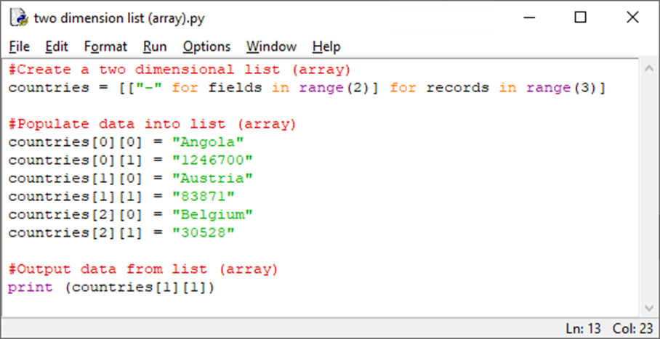
Two-dimensional arrays (Python)
You can visualise a two-dimensional array as a table with two sets of indexes – one for the rows and another for the columns.
countries
Index | 0 | 1
0 | Angola | 1246700
1 | Austria | 83871
2 | Belgium | 30528

Slide 10
Two-dimensional arrays (Python)
You can visualise a two-dimensional array as a table with two sets of indexes – one for the rows and another for the columns. “countries[0][0]” contains “Angola”.
countries
Index | 0 | 1
0 | Angola | 1246700
1 | Austria | 83871
2 | Belgium | 30528

Slide 11
Two-dimensional arrays (Python)
You can visualise a two-dimensional array as a table with two sets of indexes – one for the rows and another for the columns. “countries[0][0]” contains “Angola”.
“countries[0][1]” contains “1246700”.
countries
Index | 0 | 1
0 | Angola | 1246700
1 | Austria | 83871
2 | Belgium | 30528

Slide 12
Two-dimensional arrays (Python)
You can visualise a two-dimensional array as a table with two sets of indexes – one for the rows and another for the columns. “countries[0][0]” contains “Angola”.
“countries[0][1]” contains “1246700”.
“countries[1][1]” contains “83871”.
countries
Index | 0 | 1
0 | Angola | 1246700
1 | Austria | 83871
2 | Belgium | 30528

Slide 13
Cambridge IGCSE pseudocode
Here is an example of how these concepts will look in exam papers following the Cambridge IGCSE pseudocode format, which is listed towards the back of the syllabus.
1D and 2D arrays are declared as follows (where l, l1, l2 are lower bounds and u, u1, u2 are upper bounds):
DECLARE <identifier> : ARRAY[<l>:<u>] OF <data type>
DECLARE <identifier> : ARRAY[<l1>:<u1>, <l2>:<u2>] OF <data type>
DECLARE StudentNames : ARRAY[1:30] OF STRING
DECLARE NoughtsAndCrosses : ARRAY[1:3, 1:3] OF CHAR
StudentNames[1] ← "Ali"
NoughtsAndCrosses[2,3] ← ꞌXꞌ
StudentNames[n + 1] ← StudentNames[n]
An appropriate loop structure is used to assign the elements individually:
FOR Index ← 1 TO 30
StudentNames[Index] ← ""
NEXT Index
Arrays

Slide 14

Arrays
A static number of related data items stored in sequence within the same memory space.
Each data item has the same (homogeneous) data type.
A particular data item (element) is found using its index.
Indexes usually start at 0 for the first data item (known as zero-indexed) but can also start from 1.
Arrays may be single- or multi-dimensional.
Visualise dimensions as a column (one-dimensional) or table (two-dimensional).
Names (1D array)
Index | Name
0 | Craig
1 | Dave
2 | Sam
3 | Carol
Names and scores (2D array)
 | Name | Score
Index | 0 | 1
0 | Craig | 112
1 | Dave | 75
2 | Sam | 103
3 | Carol | 97
Note: [1][0] could also be 112 depending on how you choose to store the data. It doesn’t matter whether you visualise rows or columns first, providing you are consistent in your program. Read the question carefully in an exam so you can be sure which way around the array is being stored.
names[2] = “Sam”
names[1][0] = “Dave”

Slide 15

8.2 Arrays
Going beyond the IGCSE specification

Slide 16
Going beyond a two-dimensional array
0 1 2 3 4
One-dimensional array:
array myArray[5]
myArray[2]
Two-dimensional array:
array myArray[5,5]
myArray[2,2]
0
1
2
3
4
0
1
2
3
4

Slide 17
Going beyond a two-dimensional array
Three-dimensional array:
array myArray[5,5,5]

Slide 18
Going beyond a two-dimensional array
0 1 2 3 4
0
Three-dimensional array:
array myArray[5,5,5]
myArray[2,2,2]
1
2
3
4
0
1
2
3
4

Slide 19
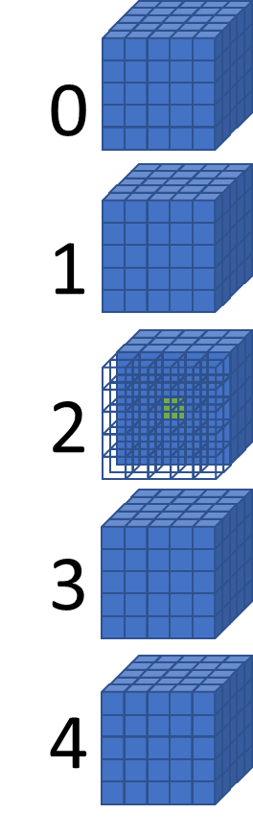
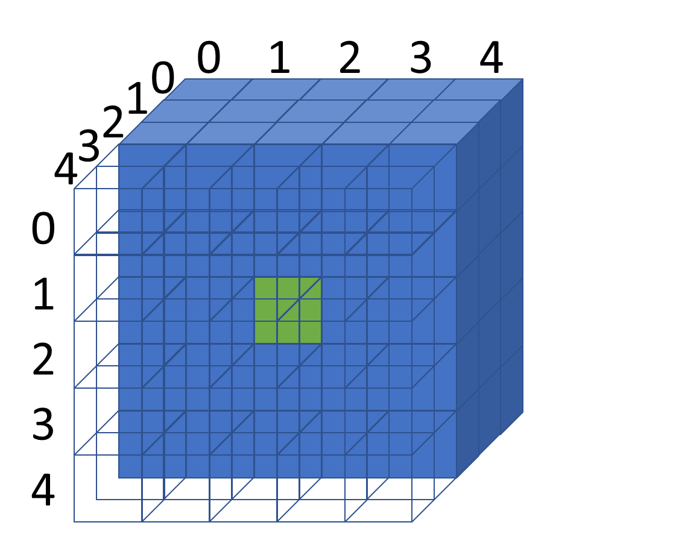
Going beyond a two-dimensional array
Four-dimensional array:
array myArray[5,5,5,5]
myArray[2,2,2,2]

Slide 20
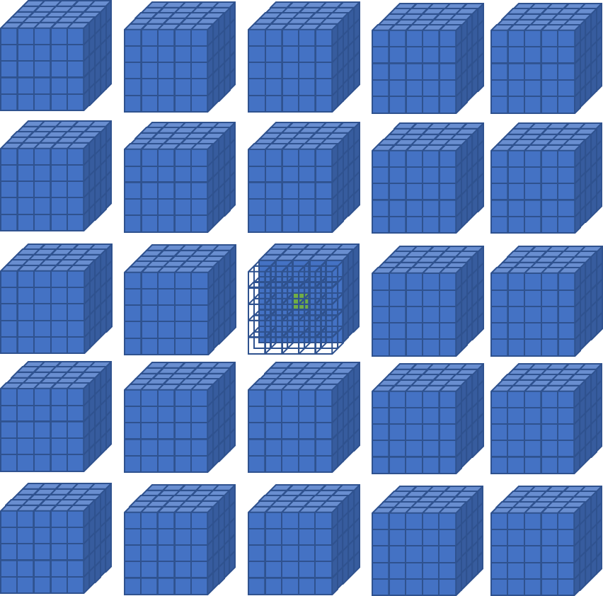
0 1 2 3 4
Going beyond a two-dimensional array
0
1
2
3
4
Five-dimensional array:
array myArray[5,5,5,5,5]
myArray[2,2,2,2,2]

Slide 21


